Slide 1
STUDENTS
MENTAL
HEALTH

Slide 2
STUDENTS
MENTAL
HEALTH
HEALT
H
EDUCAT
ION

Slide 3

Introduction
The mental health of students has been on the rise as an issue in educational institutions all over the world. There are more academic pressures, social issues, and even effects from the pandemic. As a result, there is an important concern over students' mental well-being. Student mental health survey provides essential insights into students' emotional and psychological needs. The information is then used by the institution to trace trends, analyze existing support systems, and then design specific interventions. Understanding the mental health challenges that students are facing will enable schools and universities to create a supportive environment that promotes overall well-being, reduces stigma, and encourages timely professional help for students in need.

Slide 4

OBJECTIVES
RAISING AWARENESS
The primary objective is to raise awareness about mental health issues faced by students. It is crucial to highlight the significance of this topic in educational environments.

Slide 5

orginization
The "Student Mental Health Survey" will be able to measure the mental health of students and pinpoint significant factors that have an influence on their emotional and psychological well-being. The anonymous responses collected will help understand the common stressors: academic pressure, social challenges, and personal issues. This can then highlight areas where more support is needed for students to improve understanding of the mental health concerns on campus. These findings may help in developing targeted mental health programs, counseling services, and resources to foster a more supportive, inclusive learning environment that promotes the well-being of students.

Slide 6
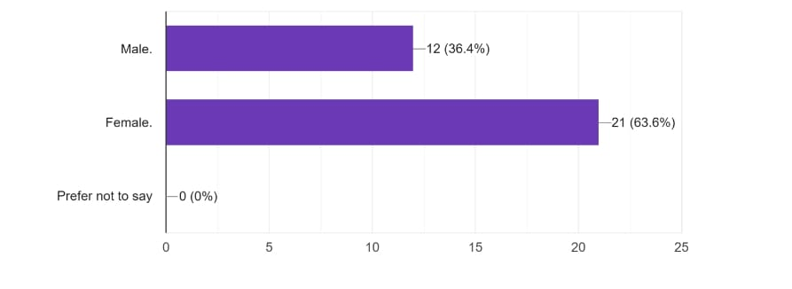
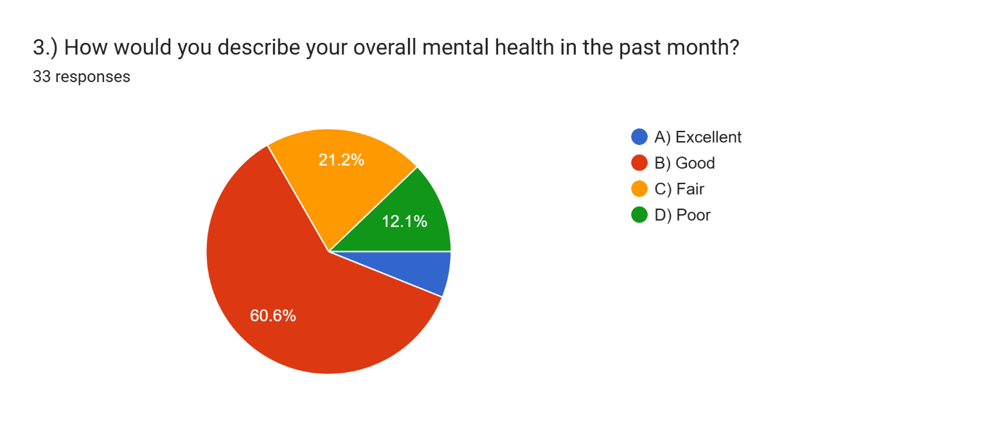

Survey
GENDER
OVER ALL MENTAL HEALTH

Slide 7
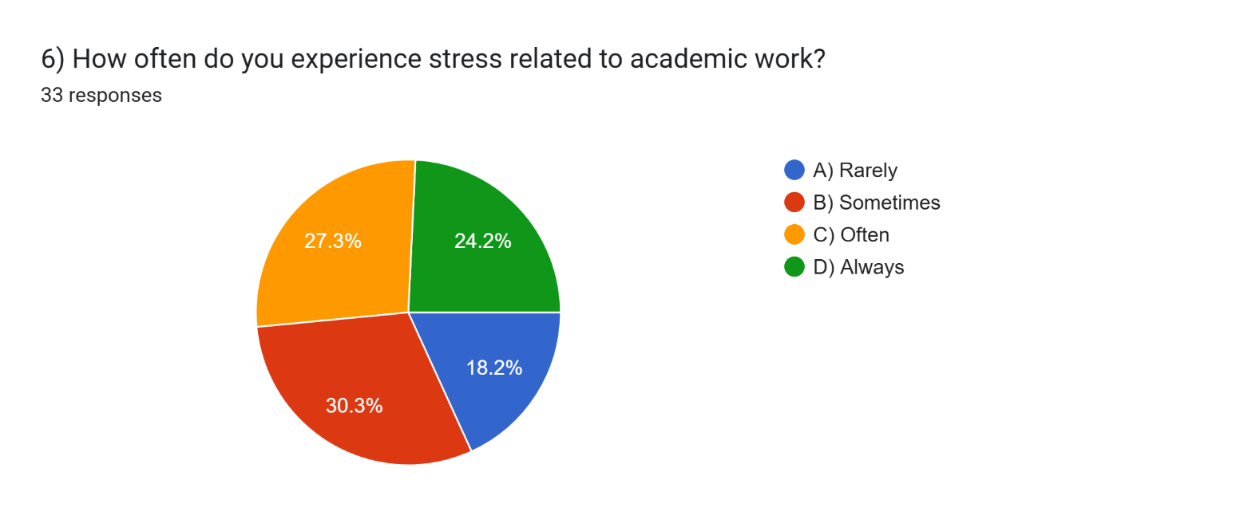
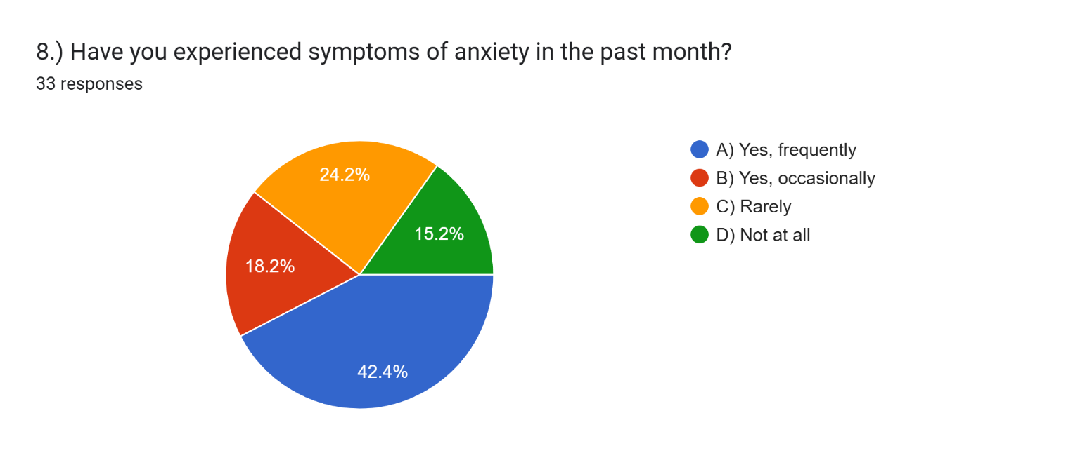
ACAMEDIC STRESS
ANXIETY RATIO

Slide 8
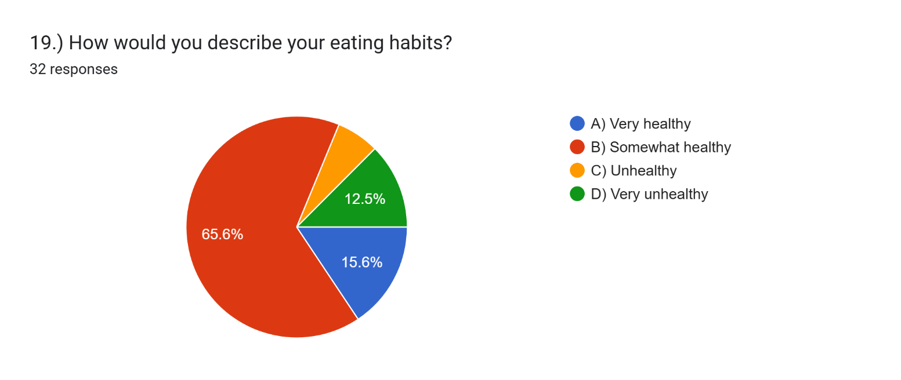
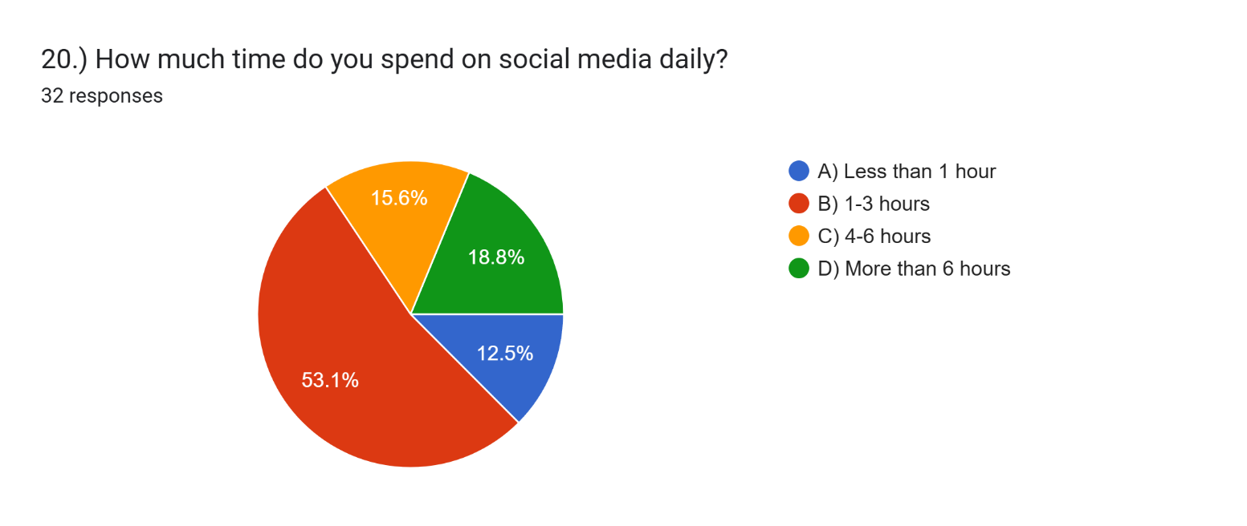
EATING HABITS
SCREEN TIME

Slide 9


RESPONDENT DEMOGRAPHICS
GEOGRAPHIC DISTRIBUTION
Mapping the responses across different regions, we can see variances in trends and attitudes. Geographic insights facilitate targeted communication and resource allocation.
AGE GROUPS
The demographics of our respondents provide insights into the age distribution. Understanding age groups is essential for tailoring future outreach and survey designs.

Slide 10
MENTAL HEALTH STATS
45%
60%
35%
IMPACT OF HIGH STRESS
COPING UTILIZATION
ANXIETY CONCERNS
High stress affects students' overall performance.
Indicates active engagement in managing mental health.
A major concern for students.

Slide 11


SURVEY OVERVIEW
KEY DEMOGRAPHICS
Participants included a diverse group representing different ages, genders, and academic disciplines, providing a comprehensive understanding of student mental health.
METHODOLOGY
The survey was conducted anonymously among students across various educational institutions to ensure honest responses regarding mental health.

Slide 12
SURVEY RESPONSES BREAKDOWN
This table summarizes the response categories from the survey. Each category provides a clear indication of the number of responses and corresponding percentage. Understanding these metrics is crucial.
CATEGORY | NUMBER OF RESPONSES | PERCENTAGE
Category A | 9 | 30%
Category B | 21 | 50%
Category C | 4 | 20%
Unanswered | 0 | 0%

Slide 13
KEY INSIGHTS
INSIGHT 1
INSIGHT 2
INSIGHT 3
The majority of respondents prefer digital communication channels over traditional methods, indicating a shift in engagement strategies.
There is a notable demand for personalized services, particularly among younger age groups. Tailoring offerings could enhance satisfaction.
Responses indicated a higher interest in sustainability initiatives, which suggests aligning future programs with environmental consciousness is crucial.

Slide 14
SUPPORT STRATEGIES
COUNSELING SERVICES
PEER SUPPORT PROGRAMS
STRESS MANAGEMENT WORKSHOPS
Providing accessible counseling services to help students deal with mental health challenges.
Encouraging the establishment of peer support groups to foster community understanding and reduce stigma.
Offering workshops that teach stress management techniques, helping students effectively cope with academic pressure.

Slide 15

CONCLUSION
SUMMARY AND ACTIONS
In summary, our survey has yielded valuable insights that can shape our strategic direction. Moving forward, we must prioritize initiatives that align with respondent interests and feedback.

